Slide 1

Designing a circuit to drive a VCSEL laser array into a coherent regime
By Yoonseo Choi, Sujay Patel, and Karthik Prasad

Slide 2
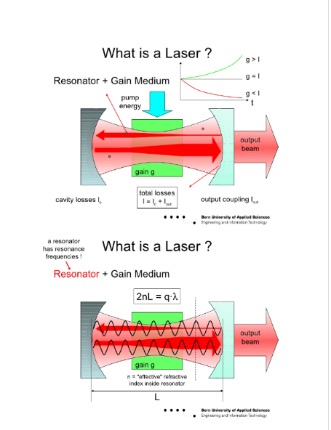
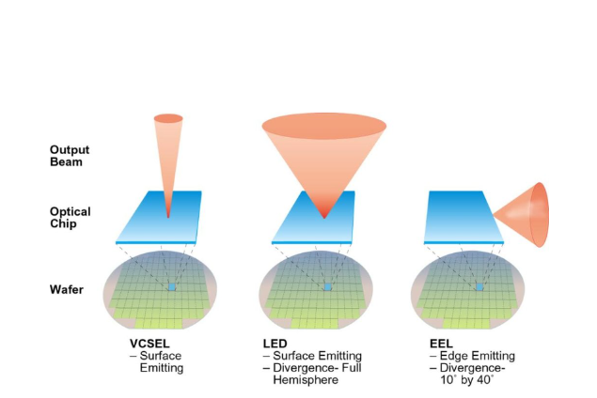
What are VCSEL Lasers, and how do we drive them to coherence?
Laser Fundamentals
Semiconductor Lasers
Coherence
Notes:
First, I'll talk a bit about how lasers work, generally. Lasers consist of a gain medium along with a system (usually mirrors) to provide optical feedback. When the gain medium is put into an excited state by an external source of energy (the power source of the laser) a state of population inversion is reached, and light is amplified into a coherent output.
There are two main types of semiconductor lasers (lasers in which the gain medium is a semiconductor) - surface emitting and edge emitting. VCSEL lasers are a type of surface-emitting laser and are used in many modern applications, such as computer mice and fiberoptic cables.
In this project, we're trying to drive an array of VCSEL lasers into coherence, where groups of VCSEL laser beams are "synchronized" into operating as a single, more powerful laser. This state is desirable to achieve because the power of a single merged beam is greater than the sum of the powers of the individual laser beams. We look for this coherence state by slowly increasing the current provided to the array while measuring the change in differential resistance – from the research our mentor, Pawel, has done, a sharp change in differential resistance seems to indicate that we've reached the coherent state. Differential Resistance is the rate of change of voltage with respect to current – in a device with non-ohmic resistance like the VCSEL laser, this is the primary way we can measure the relationship between voltage and current.

Slide 3
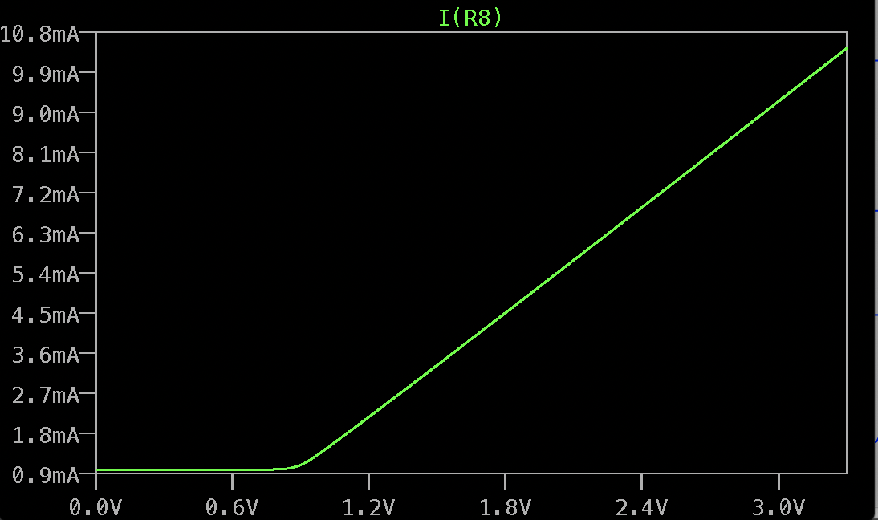
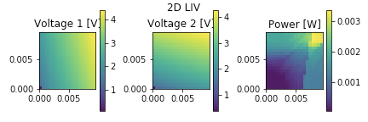
Simulating the behavior of the VCSEL and the circuit
VCSELs are current controlled devices
Microcontroller(DAC) -> Current pump(VCCS) -> VCSEL -> Microcontroller(ADC)
Computing the differential resistance
Microcontroller <-> Python Current source <-> LT-Spice simulation VCSEL <-> LIV characteristics

Slide 4
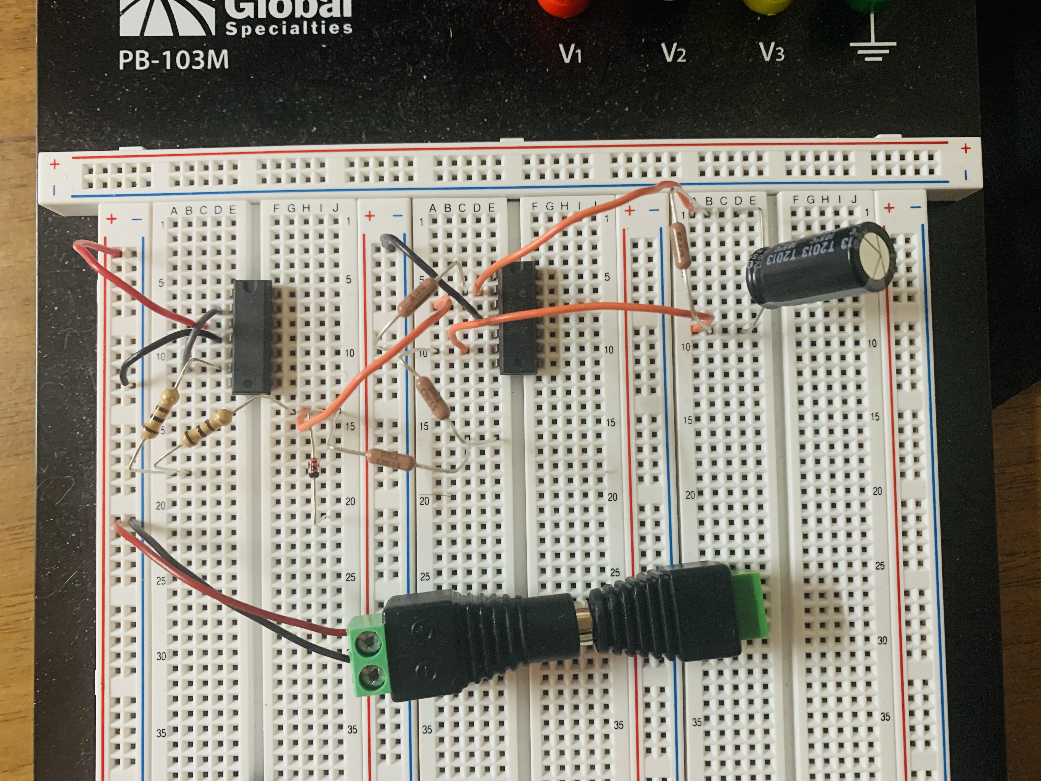
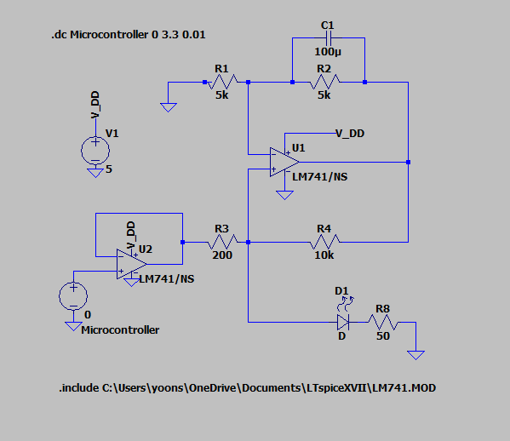
How are we planning on physically implementing our circuit to control the VCSEL?
Physical design limitations, unintended side-effects, etc.
Integrating two current sources to a VCSEL and microcontroller
Physical Implementation (Power Supply courtesy of Mika Lillian Lew)
Modified Howland Current Pump (Tex. Instr.)

Slide 5
Our Goals
Improve reliability of detection by directly measuring the output power through a photodiode
Integrating circuit with the VCSEL

